Slide 1

The National University of Computer and Emerging Sciences
Introduction to Deep Networks
Machine Learning for Data Science
Dr. Akhtar Jamil
Department of Computer Science

Slide 2
Goals
Feature Engineering
Introduction to Deep Networks
Automatic Feature Extraction
Convolutional Neural Networks

Slide 3
Feature Engineering
Feature engineering is the process of selecting, manipulating, and transforming raw data into valuable features.
To apply Machine Learning.
It might be necessary to design and train better features.
Converting raw observations into desired features
Enhancing model accuracy

Slide 4
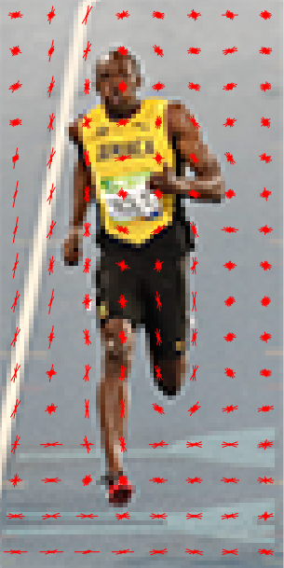
Calculate the Histogram of Oriented Gradients
0.3 | 8 | 0.6 | 5 | 36 | 2 | 32.2 | 23.0 | 23 | 43
Machine Learning Model

Slide 5
Why Deep Learning Now?
Artificial Intelligence is decades old
Breakthroughs in the field of artificial neural networks are exploding the deep learning.
Deep learning got boom in recent times
Companies use advanced computational techniques to find useful information hidden in huge data.

Slide 6
Why Deep Learning Now?
How to create intelligent, self-learning machines that can have similar perception as human?
There are three main drivers:
Advanced neural networks
Availability of huge amount of training data
E.g. ImageNet, MS-COCO, MNIST
Extremely powerful distributed GPU-based systems
Example of Open Datasets:

Slide 7

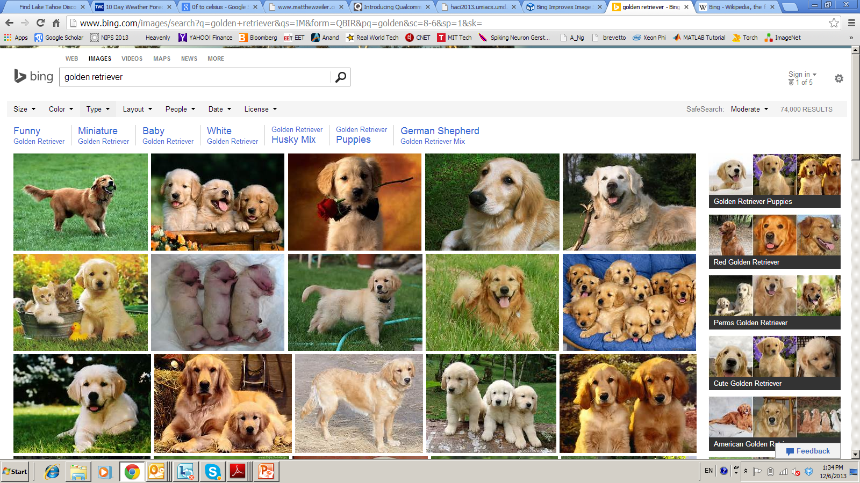


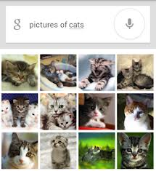

Deep Learning – from Research to Technology
Deep Learning - breakthrough in visual and speech recognition

Slide 8

Classical Computer Vision Pipeline

Slide 9
Classical Computer Vision Pipeline.
CV experts
Select / develop features: SURF, HoG, SIFT, RIFT
Add on top of this Machine Learning for multi-class recognition and train classifier
Feature
Extraction:
SIFT, HoG...
Detection,
Classification
Recognition
Classical CV feature definition is domain-specific and time-consuming

Slide 10
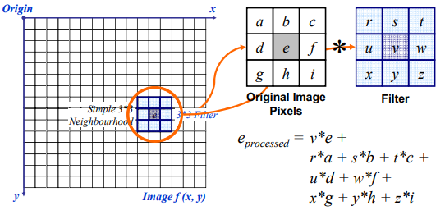
Classical Computer Vision Pipeline.

Slide 11
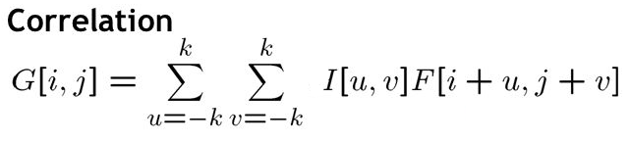
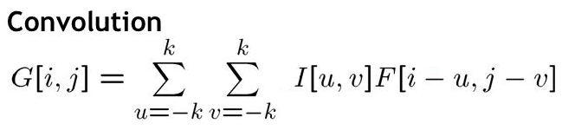
Classical Computer Vision Pipeline.
G[i,j]=u=-kk v=-kk I[u,v]F[i+u,j+v]
Convolution and Correlation

Slide 12
Deep Learning –based Vision Pipeline.
Deep Learning:
Build features automatically based on training data
Combine feature extraction and classification
DL experts: define NN topology and train NN
Deep NN...
Detection,
Classification
Recognition
Deep Learning promise:
obtain good feature automatically,
We can apply same method for other problems

Slide 13
Deep Learning Basics
Deep Learning – is a set of machine learning algorithms based on multi-layer networks
CAT
DOG
OUTPUTS
HIDDEN
NODES
INPUTS

Slide 14


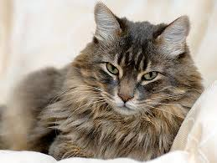

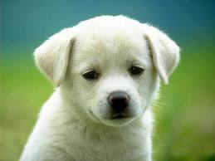

Deep Learning Basics
Deep Learning – is a set of machine learning algorithms based on multi-layer networks
CAT
DOG
Training

Slide 15

Deep Learning Basics
Deep Learning – is a set of machine learning algorithms based on multi-layer networks
CAT
DOG

Slide 16
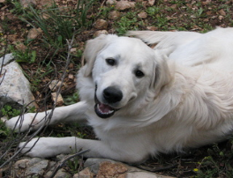
Deep Learning Basics
Deep Learning – is a set of machine learning algorithms based on multi-layer networks
CAT
DOG

Slide 17
Deep Feedforward Networks
Deep feedforward networks, also called feedforward neural networks, or multilayer perceptrons (MLPs), are the essential deep learning models.
The goal of a feedforward network is to approximate some function f that maps the input to the output category y = f(x) maps an input x to a category y.
A feedforward network defines a mapping y = f(x; θ ) and learns the value of the parameters that result in the best function approximation.

Slide 18
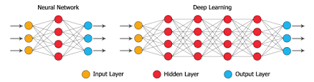
Deep Feedforward Networks

Slide 19
Deep Feedforward Networks
There are simple linear models such as logistic regression and linear regression
They can fit data efficiently and reliably
These models are limited to linear functions
They cannot understand the nonlinearity in data

Slide 20
Deep Feedforward Networks
Can we extend the linear models to represent nonlinear functions of x
We can apply the linear model not to x itself but to a transformed input φ(x), where φ is a nonlinear transformation.
We can think of φ as providing a set of features describing x, or as providing a new representation for x.

Slide 21
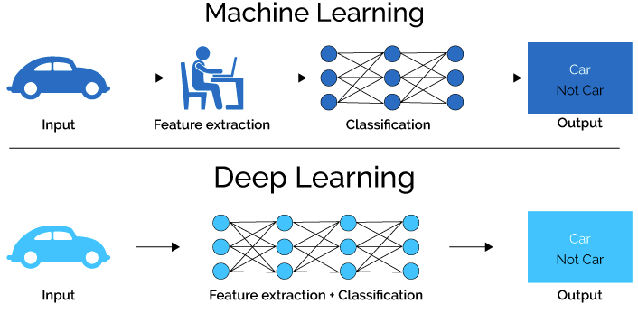
Deep Feedforward Networks

Slide 22
Introduction to Convolutional Neural Networks

Slide 23
What are CNNs ?
CNN = Neural Network with a convolution operation
Convolutional neural networks (CNN, ConvNet) is a class of deep, feed-forward (not recurrent) artificial neural networks that are applied to analyzing visual imagery.
Consists of Matrix Multiplication in at least one of the layers

Slide 24
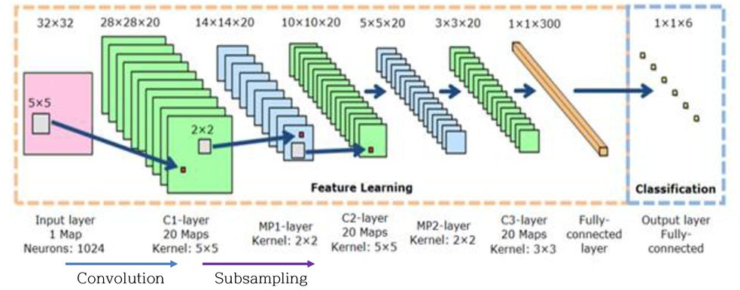
CNN architecture

Slide 25
Convolutional Neural Networks (CovNet)
In a nutshell, A ConvNet usually has 3 types of layers: 1) Convolutional Layer (CONV) 2) Pooling Layer (POOL) 3) Fully Connected Layer (FC)

Slide 26
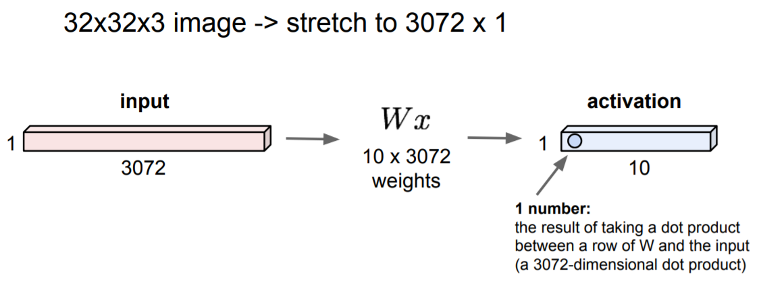
Fully Connected Layer

Slide 27
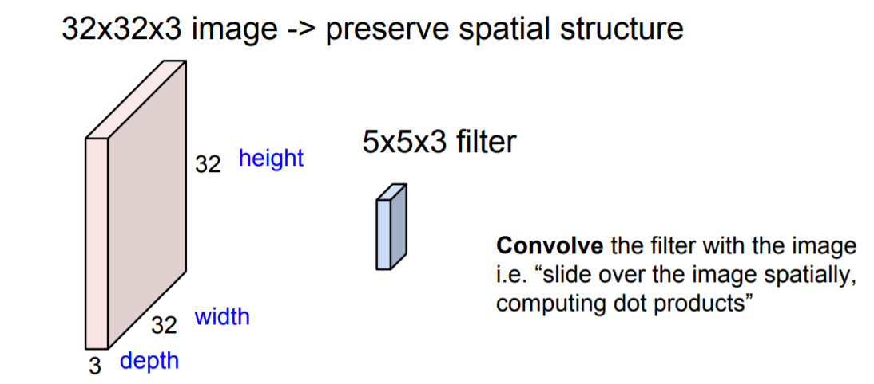
Convolution Layer

Slide 28

Review: Convolution

Slide 29
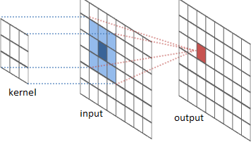
The convolution operation

Slide 30
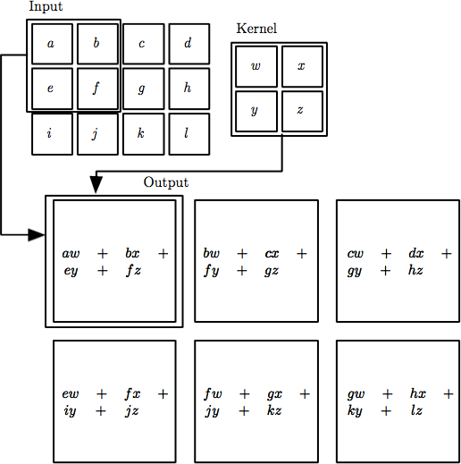

The convolution operation
Local Connectivity. Neurons will connect to only a local region of the input volume.
The spatial extent of this connectivity is a hyperparameter called the receptive field of the neuron (equivalently this is the filter size).

Slide 31
Convolution Layer
32x32x3 image
32
height
32
depth
width
3

Slide 32
Convolution Layer
32x32x3 image
5x5x3 filter
32
Convolve the filter with the image
i.e. “slide over the image spatially, computing dot products”
32
3

Slide 33
Convolution Layer
Filters always extend the full
32x32x3 image
depth of the input volume
5x5x3 filter
32
Convolve the filter with the image
i.e. “slide over the image spatially, computing dot products”
32
3

Slide 34
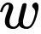
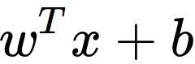
Convolution Layer
32x32x3 image 5x5x3 filter
32
1 number:
the result of taking a dot product between the filter and a small 5x5x3 chunk of the image
(i.e. 5*5*3 = 75-dimensional dot product + bias)
32
3

Slide 35
Convolution Layer
activation map
32x32x3 image 5x5x3 filter
32
28
convolve (slide) over all spatial locations
32
28
3
1

Slide 36
Convolution Layer
32x32x3 image 5x5x3 filter
activation maps
32
28
convolve (slide) over all spatial locations
32
28
consider a second, green filter
3
1

Slide 37
For example, if we had 6 5x5 filters, we’ll get 6 separate activation maps:
activation maps
32
28
Convolution Layer
32
28
3
6
We stack these up to get a “new image” of size 28x28x6!

Slide 38
Preview: ConvNet is a sequence of Convolutional Layers, interspersed with activation functions
32
28
24
….
CONV, ReLU
e.g. 6 5x5x3 filters
CONV, ReLU
e.g. 10 5x5x6 filters
CONV, ReLU
32
28
24
3
6
10

Slide 39
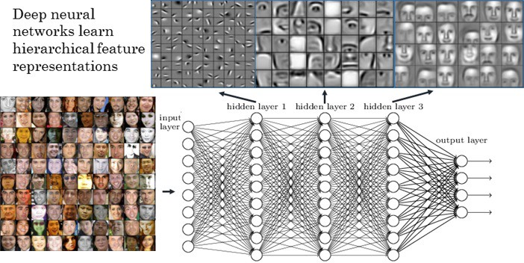
Visualize the Results

Slide 40
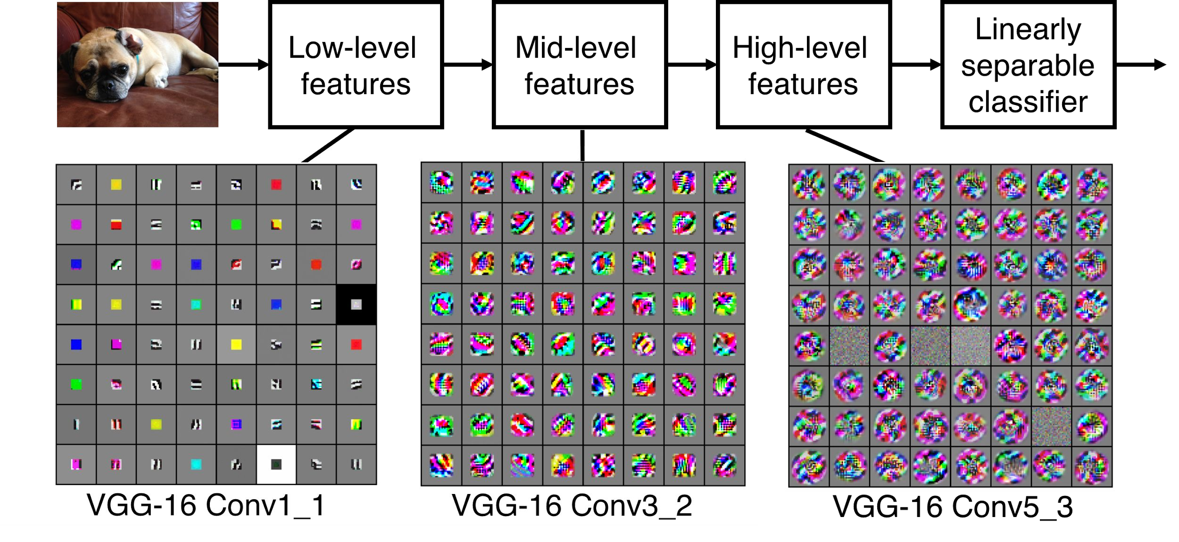
Preview
[Zeiler and Fergus 2013]
Visualization of VGG-16 by Lane McIntosh. VGG-16 architecture from [Simonyan and Zisserman 2014].
Fei-Fei Li & Justin Johnson & Serena Yeung April 18, 2017Lecture 5 -

Slide 41
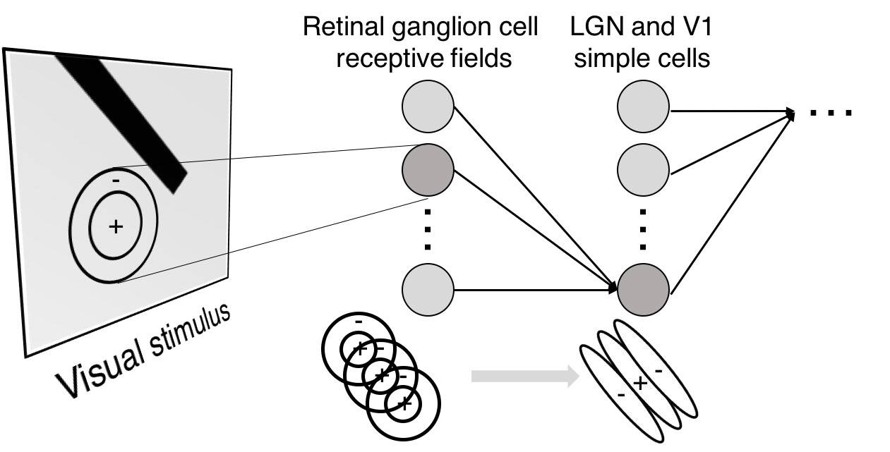
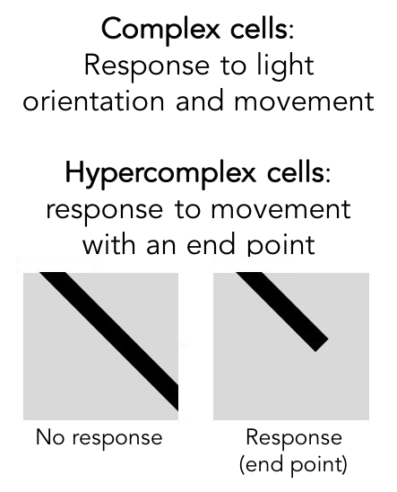
Preview

Slide 42
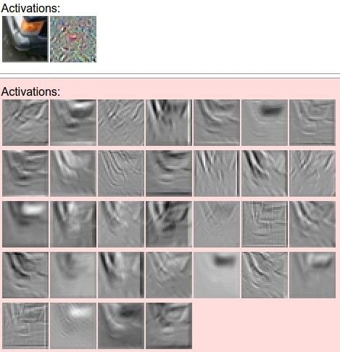
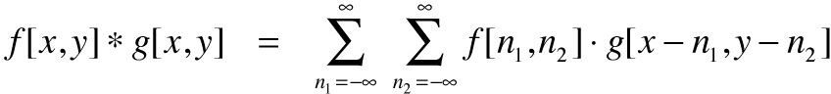
one filter =>
one activation map
example 5x5 filters
(32 total)
We call the layer convolutional because it is related to convolution of two signals:
elementwise multiplication and sum of a filter and the signal (image)
Figure copyright Andrej Karpathy.

Slide 43

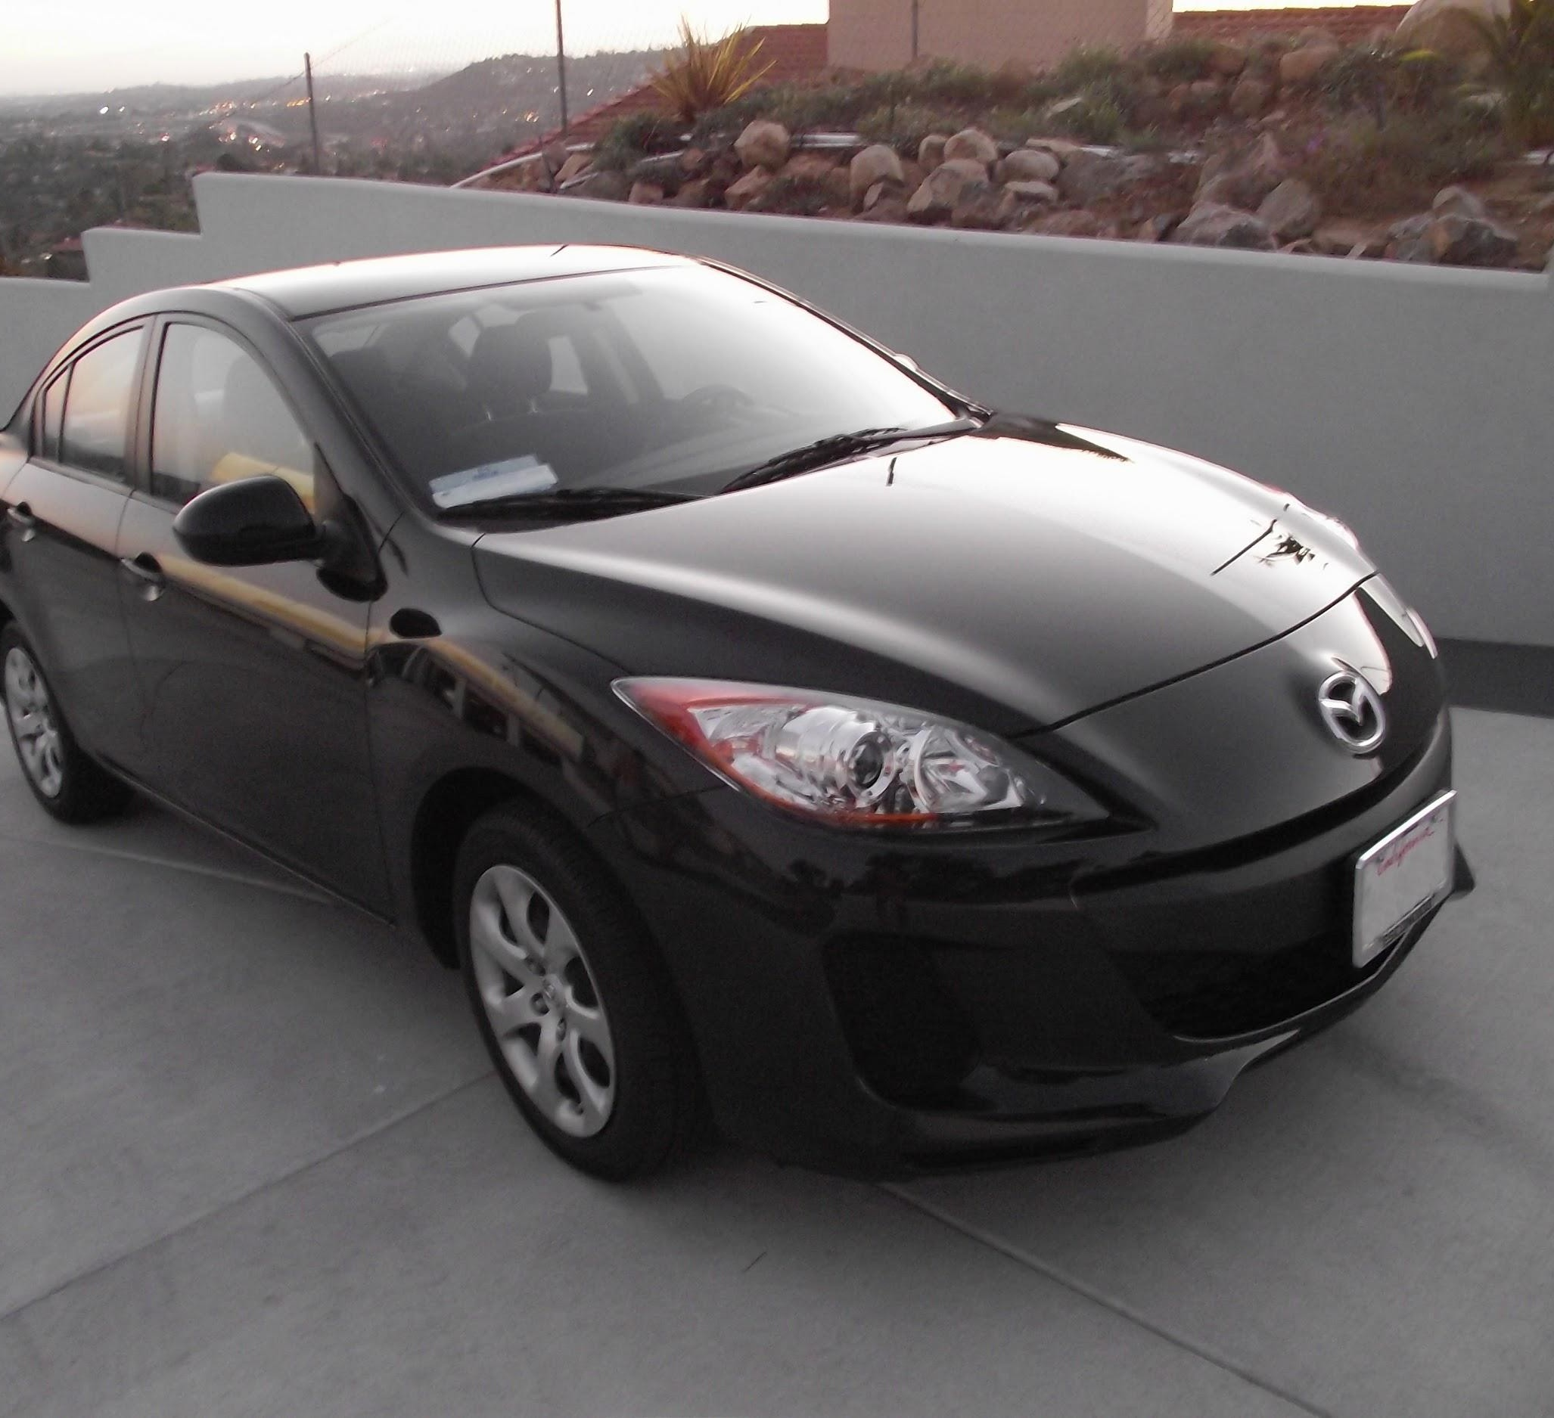
preview:
Fei-Fei Li & Justin Johnson & Serena Yeung April 18, 2017Lecture 5 -

Slide 44
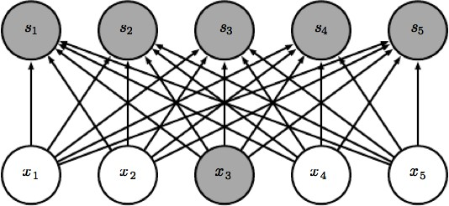

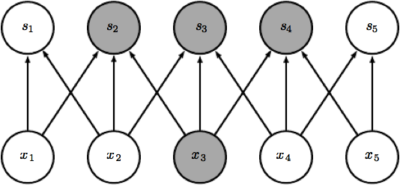

Reason 1 : Sparse Connectivity

Slide 45
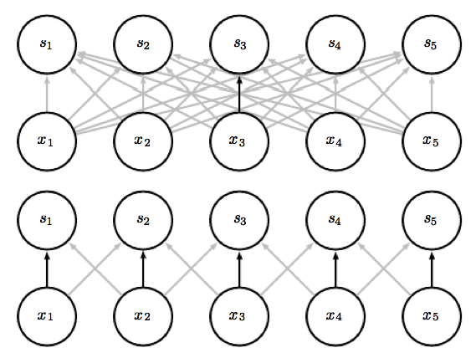
Reason 2 : Parameter sharing

Slide 46
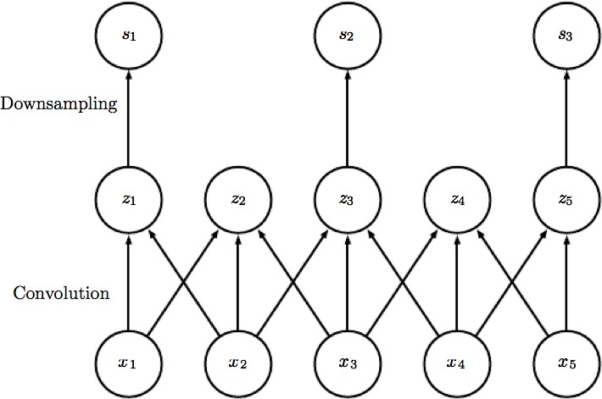
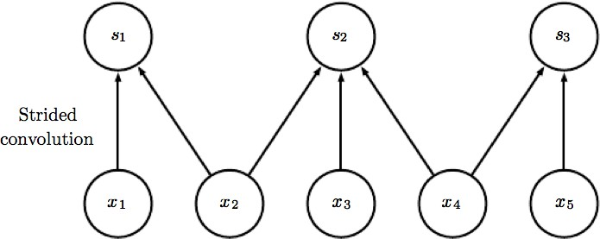
Stride

Slide 47
A closer look at spatial dimensions:
7
7x7 input (spatially) assume 3x3 filter
7

Slide 48
A closer look at spatial dimensions:
7
7x7 input (spatially) assume 3x3 filter
7

Slide 49
A closer look at spatial dimensions:
7
7x7 input (spatially) assume 3x3 filter
7

Slide 50
A closer look at spatial dimensions:
7
7x7 input (spatially) assume 3x3 filter
7

Slide 51
A closer look at spatial dimensions:
7
7x7 input (spatially) assume 3x3 filter
=> 5x5 output
7

Slide 52
A closer look at spatial dimensions:
7
7x7 input (spatially) assume 3x3 filter applied with stride 2
7

Slide 53
A closer look at spatial dimensions:
7
7x7 input (spatially) assume 3x3 filter applied with stride 2
7

Slide 54
A closer look at spatial dimensions:
7
7x7 input (spatially) assume 3x3 filter applied with stride 2
=> 3x3 output!
7

Slide 55
A closer look at spatial dimensions:
7
7x7 input (spatially) assume 3x3 filter applied with stride 3?
7

Slide 56
A closer look at spatial dimensions:
7
7x7 input (spatially) assume 3x3 filter applied with stride 3?
7
doesn’t fit!
cannot apply 3x3 filter on 7x7 input with stride 3.

Slide 57
N
Output size:
(N - F) / stride + 1
 |  |  | F
 | F
e.g. N = 7, F = 3:
stride 1 => (7 - 3)/1 + 1 = 5
stride 2 => (7 - 3)/2 + 1 = 3
stride 3 => (7 - 3)/3 + 1 = 2.33 :\
N

Slide 58
Zero-Padding: common to the border
0 | 0 | 0 | 0 | 0 | 0
0
0
0
0
e.g. input 7x7
3x3 filter, applied with stride 1
pad with 1 pixel border => what is the output?
(recall:)
(N - F) / stride + 1

Slide 59
Zero-Padding: common to the border
0 | 0 | 0 | 0 | 0 | 0
0
0
0
0
e.g. input 7x7
3x3 filter, applied with stride 1
pad with 1 pixel border => what is the output?
7x7 output!

Slide 60
Examples time:
Input volume: 32x32x3
10 5x5 filters with stride 1, pad 2
Number of parameters in this layer?

Slide 61
Examples time:
Input volume: 32x32x3
10 5x5 filters with stride 1, pad 2
Number of parameters in this layer? each filter has 5*5*3 + 1 = 76 params
=> 76*10 = 760
(+1 for bias)

Slide 62
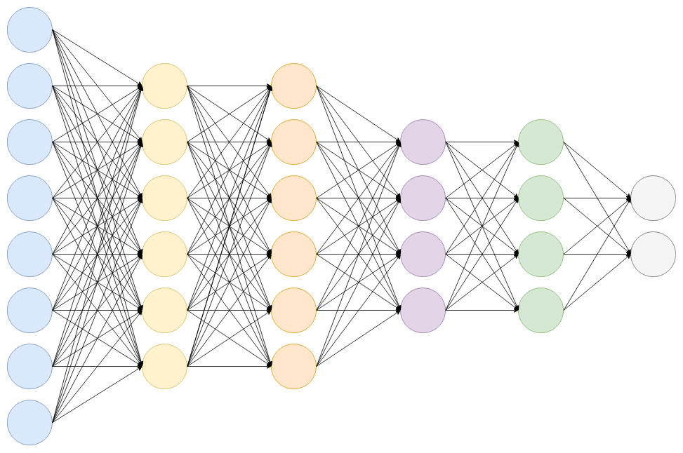
Fully Connected Layers
Fully Connected Layer is simply, feed forward neural networks.
Added in last few layers in the network.
The output from the final Pooling or Convolutional Layer, which is flattened and then fed into the fully connected layer.

Slide 63
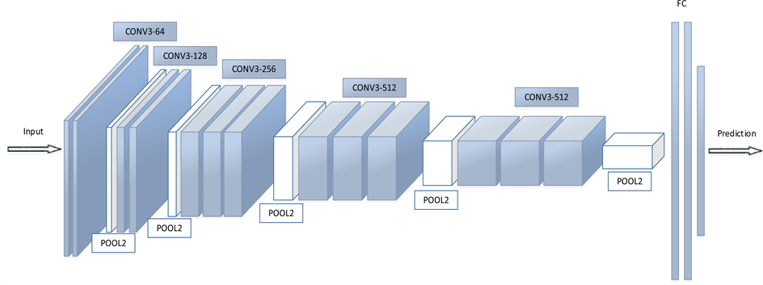
Fully Connected Layers

Slide 64
Fully Connected Layers
Regular neural network
This layer takes an input volume from last layer of CNN and outputs an N dimensional vector.
Where N is the number of classes

Slide 65
Pooling Layer
Pooling is used to progressively reduce the spatial size of the input
To reduce the amount of parameters and computation
It control overfitting (regularization).
Invariance to small translations of the input
Commonly insert a Pooling layer in-between successive Conv layers

Slide 66
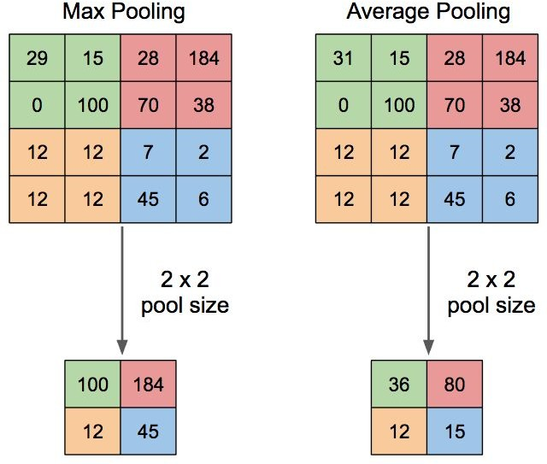
Pooling Layer

Slide 67
Batch Normalization
Usually the input layer scaled.
For example, when we have some features whose value are from 0 to 1 and some from 1 to 1000, we should normalize them to speed up learning.
Can we normalize the hidden layers also?
YES

Slide 68
Batch Normalization
It increases the stability of a neural network
Normalizes the output of a previous activation layer by subtracting the batch mean and dividing by the batch standard deviation.
Batch normalization adds two trainable parameters to each layer
The normalized output is multiplied by a “standard deviation” parameter (gamma)
and add a “mean” parameter (beta)

Slide 69
Dropout
The term “dropout” refers to dropping out units (both hidden and visible) in a neural network.
It is a way to preventing overfitting problem
These units are not considered during a particular forward or backward pass
A new hyperparameter is introduced that specifies the probability at which outputs of the layer are dropped out
Dropout: A Simple Way to Prevent Neural Networks from Overfitting

Slide 70
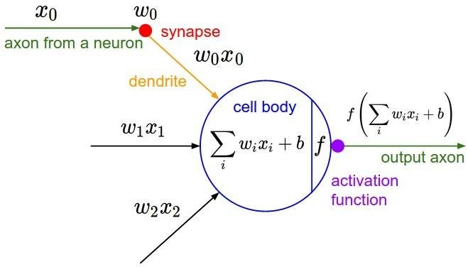
Activation Functions

Slide 71
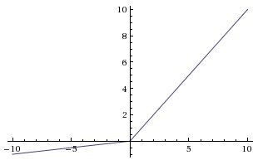
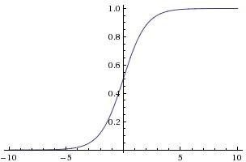
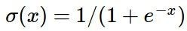
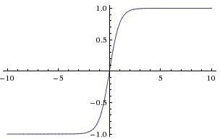
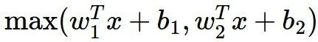
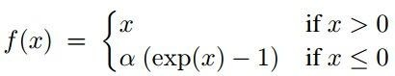
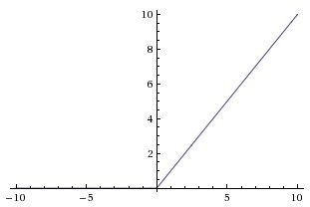
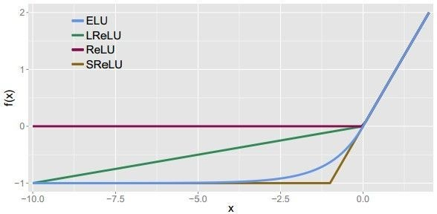
Activation Functions
Sigmoid
Leaky ReLU
Maxout
ELU
tanh
tanh(x)
ReLU
max(0,x)

Slide 72
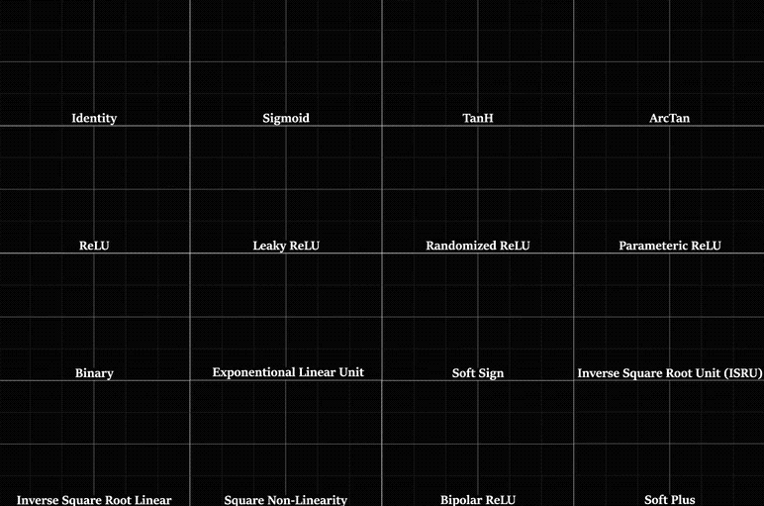

Slide 73
References
Fei-Fei Li & Justin Johnson & Serena Yeung
Deep Learning Book by Ian Goodfellow
https://www.youtube.com/channel/UCcIXc5mJsHVYTZR1maL5l9w
https://www.deeplearning.ai/
https://profiles.stanford.edu/fei-fei-li?tab=research-and-scholarship

Slide 74
Thank You ☺

